Slide 1
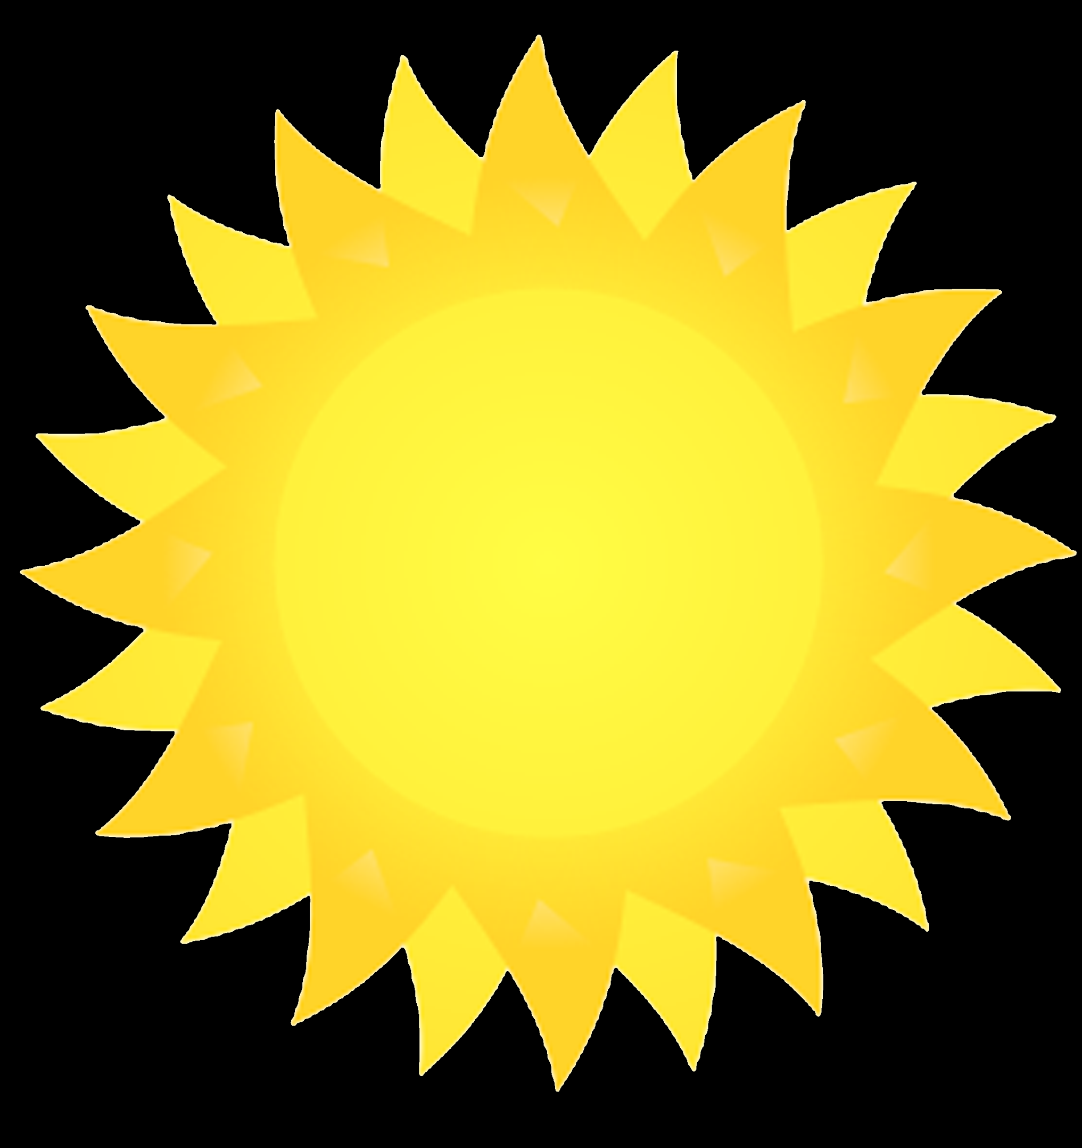
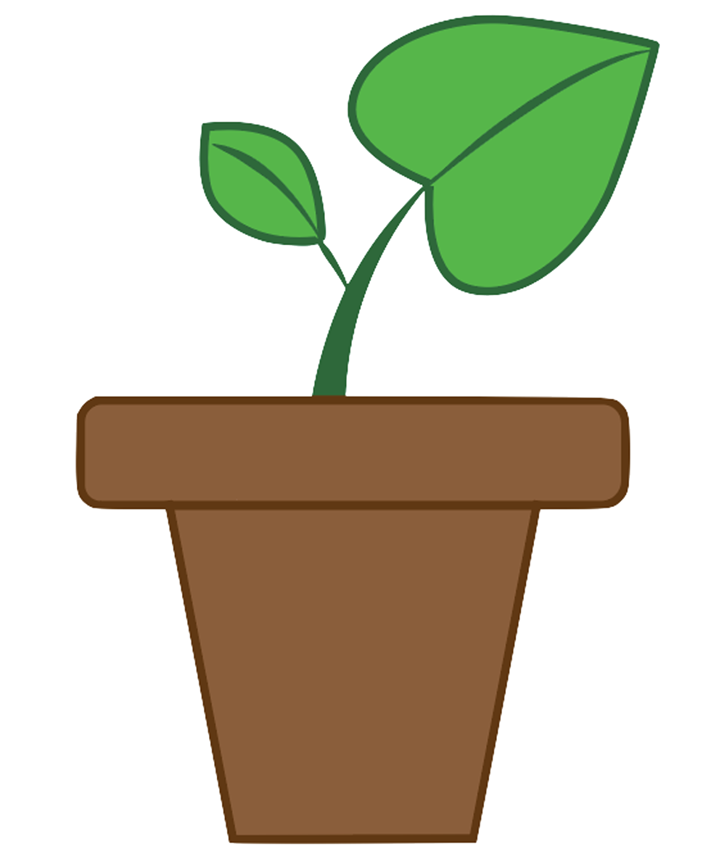
Internet of Things
for
Healthy Plants
Notes:
Use google chrome!! Cantonese!

Slide 2
Link to this PowerPoint:
https://tinyurl.com/y26yp6qn

Slide 3
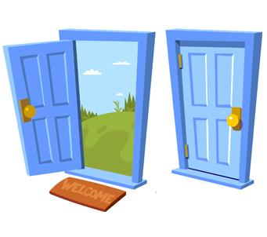
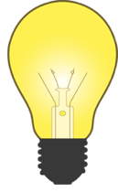



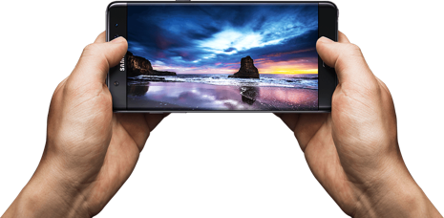
Internet of Things (IOT)
The ability connect objects/devices using the internet!

Slide 4


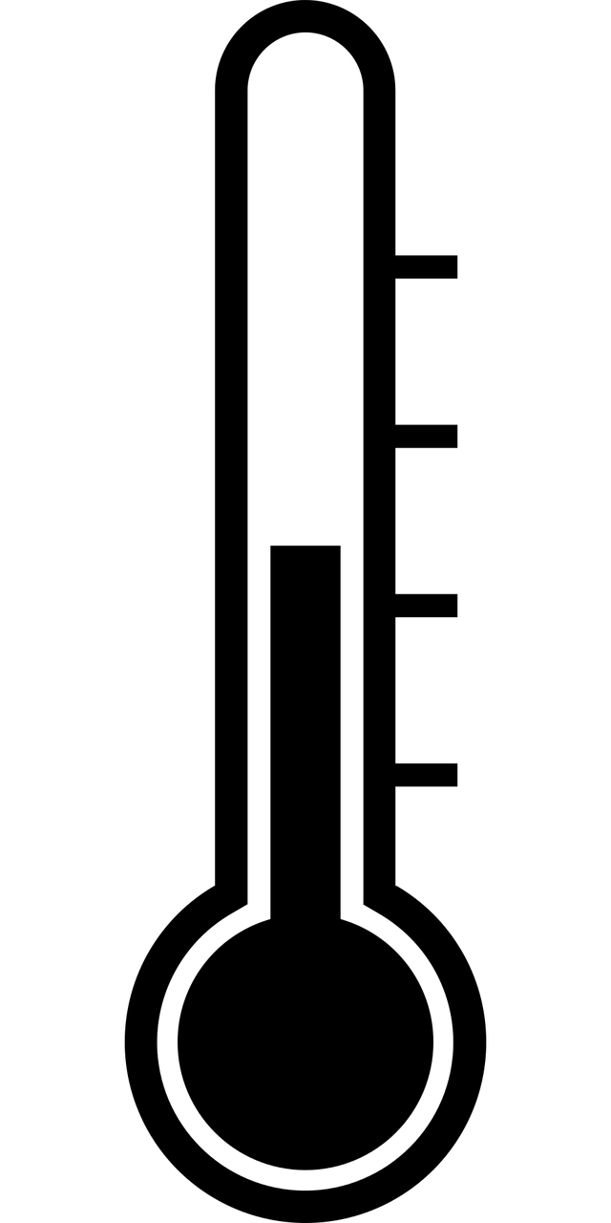
IOT for Healthy Plants
What kind of energy and resources help plants grow healthy and strong?

Slide 5
Grove
Arduino kit to help us with this project!
Has a variety of sensors to help us with the building process.

Slide 6
Our kit!

Slide 7
A2 : Moisture Sensor
D4: Temperature Sensor
I2C: LCD Screen
A1: Light Sensor

Slide 8
https://tinyurl.com/y6g7t3za

Slide 9
Temperature Range: 50-75 F, 10-23
Percent Moisture in Soil: Moderate water
Light: Full light for 4-6hrs a day

Slide 10
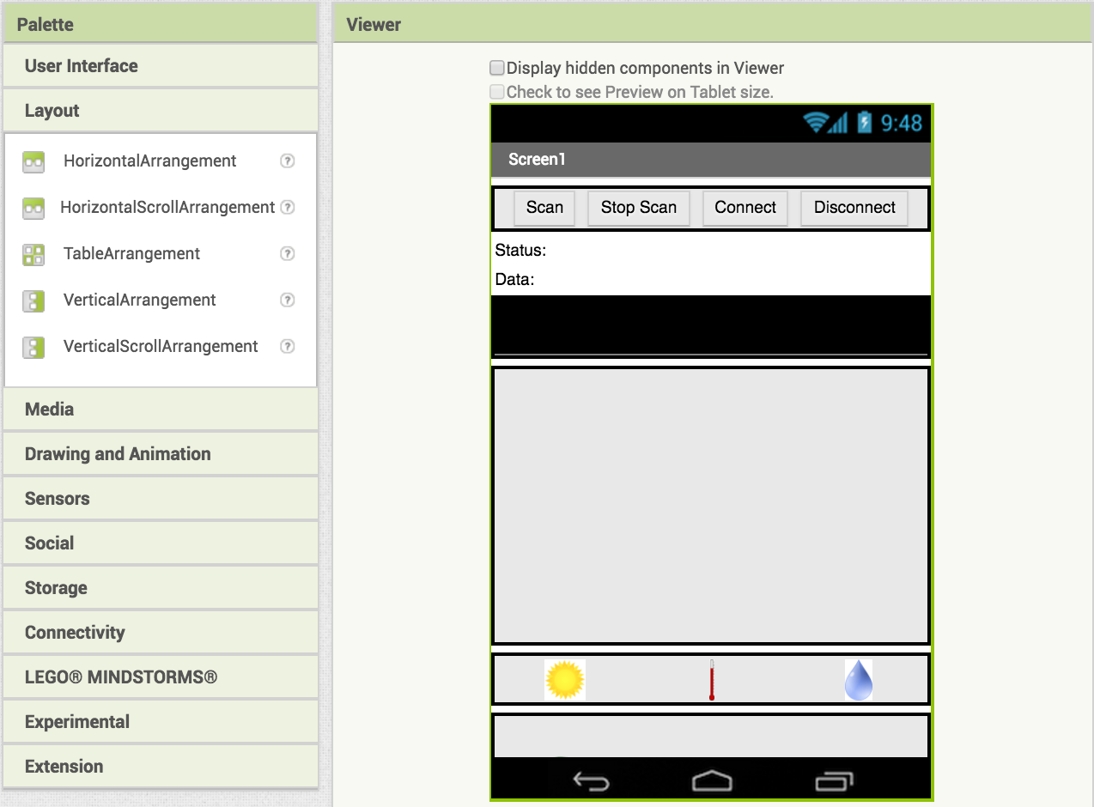
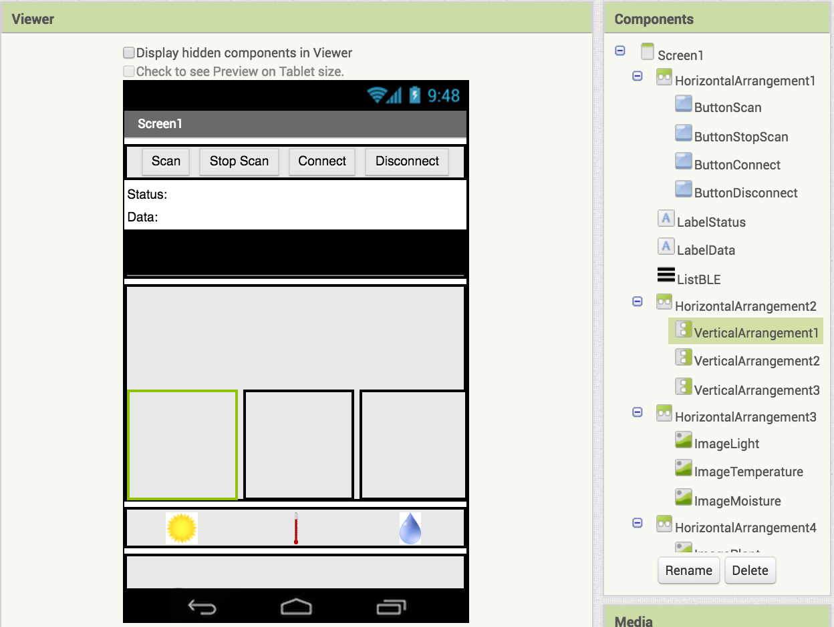
Adding Graphs
Add 3 VerticalArrangements inside the HorizontalArrangement
3x
Your screen should now look like this:

Slide 11
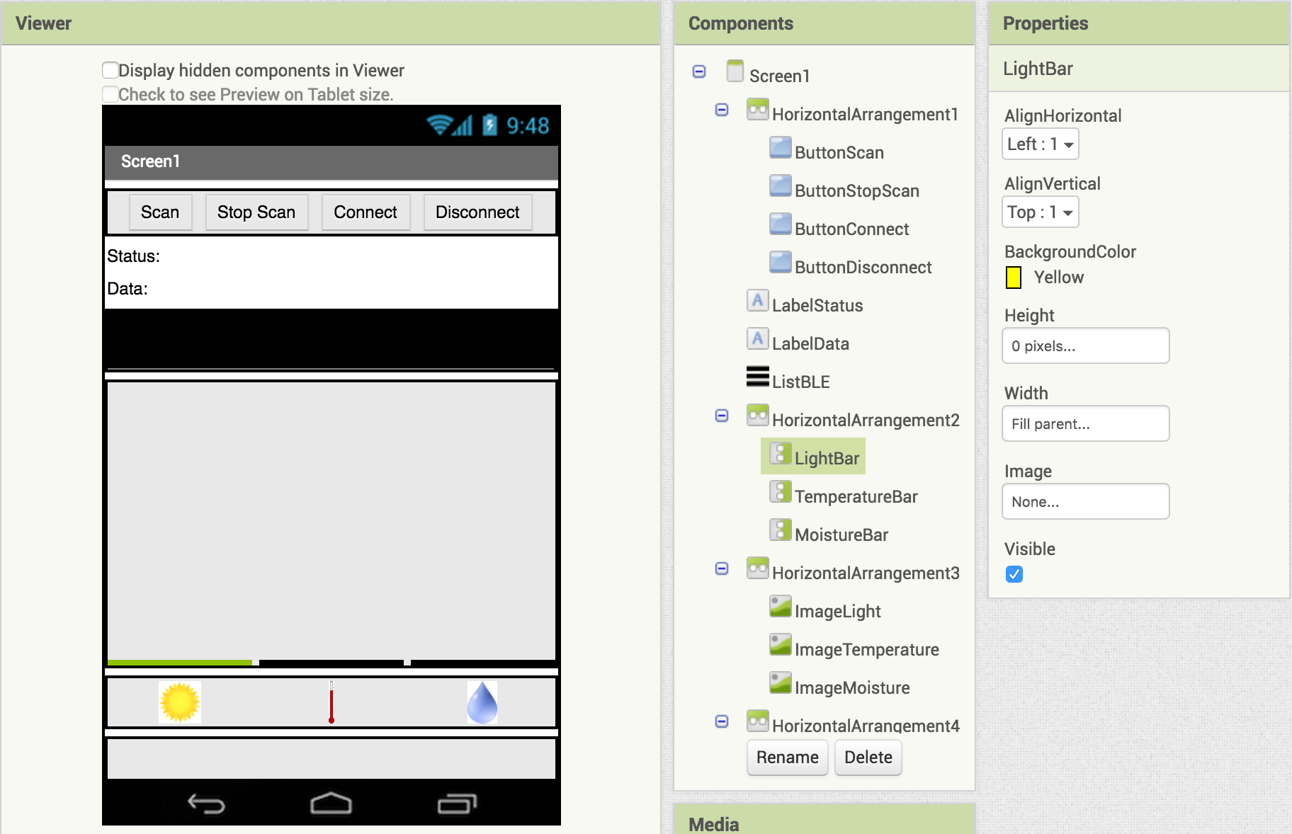
Rename them LightBar, TemperatureBar, MoistureBar

Slide 12

Set each bar's height to 0px and width to Fill Parent
Now set LightBar BackgroundColor to Yellow, TemperatureBar BackgroundColor to Red, and MoistureBar BackgroundColor to Blue
The boxes should now look flat

Slide 13

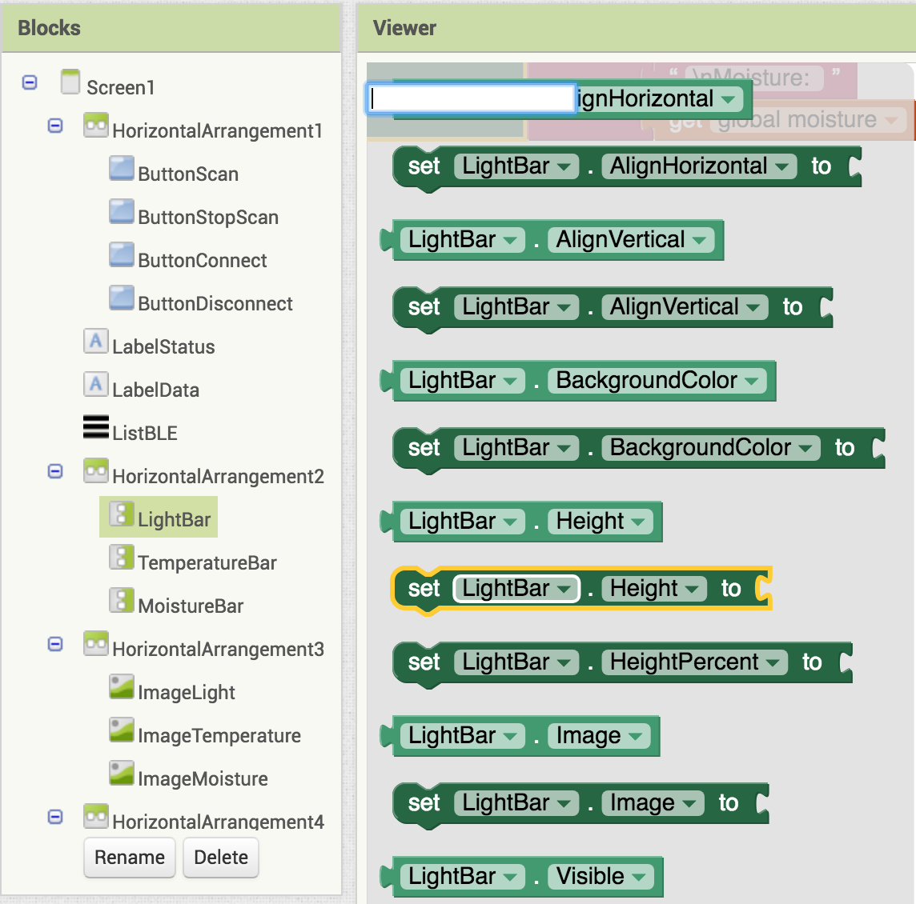


Switch to the Blocks Editor view
Now we will change the sizes of the graphs based on the readings we get
Drag in
Find
and connect them together

Slide 14
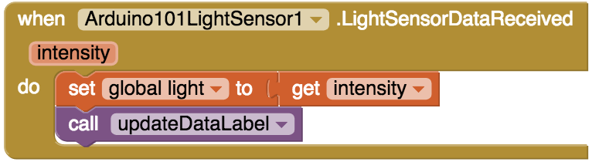
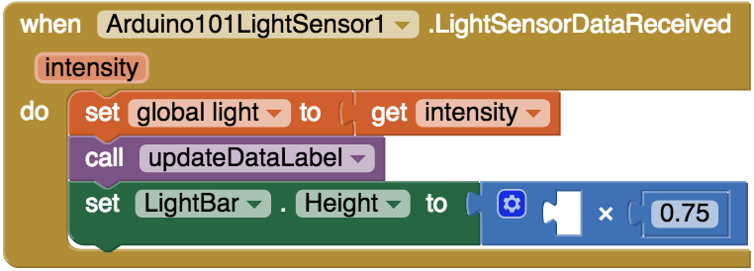
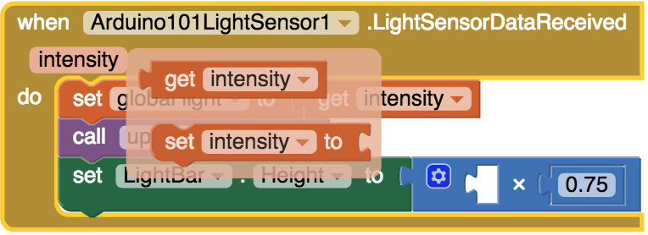
Find
Add your other blocks
Hover your mouse over the word "intensity"
A popup should appear

Slide 15

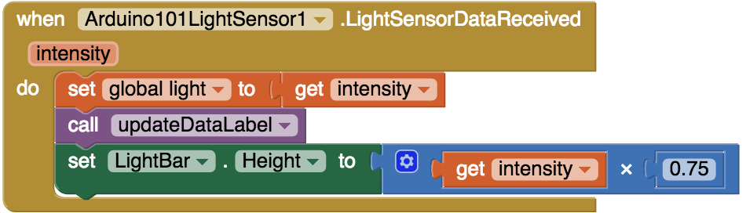
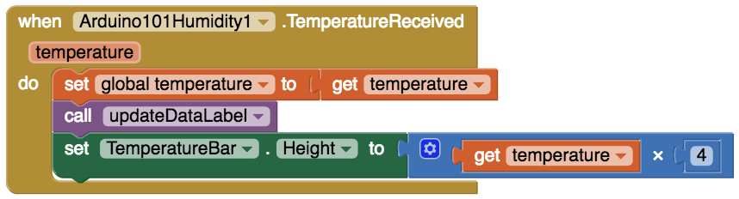
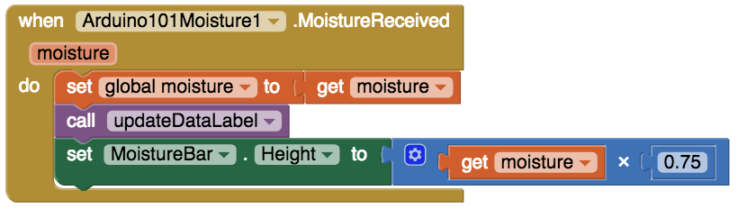
Drag into the open part of your code
(this gets the light reading from the sensor)
Do the same thing for MoistureBar and TemperatureBar. They should look like this when you are done
Now try out your app and see what happens to the bars!

Slide 16
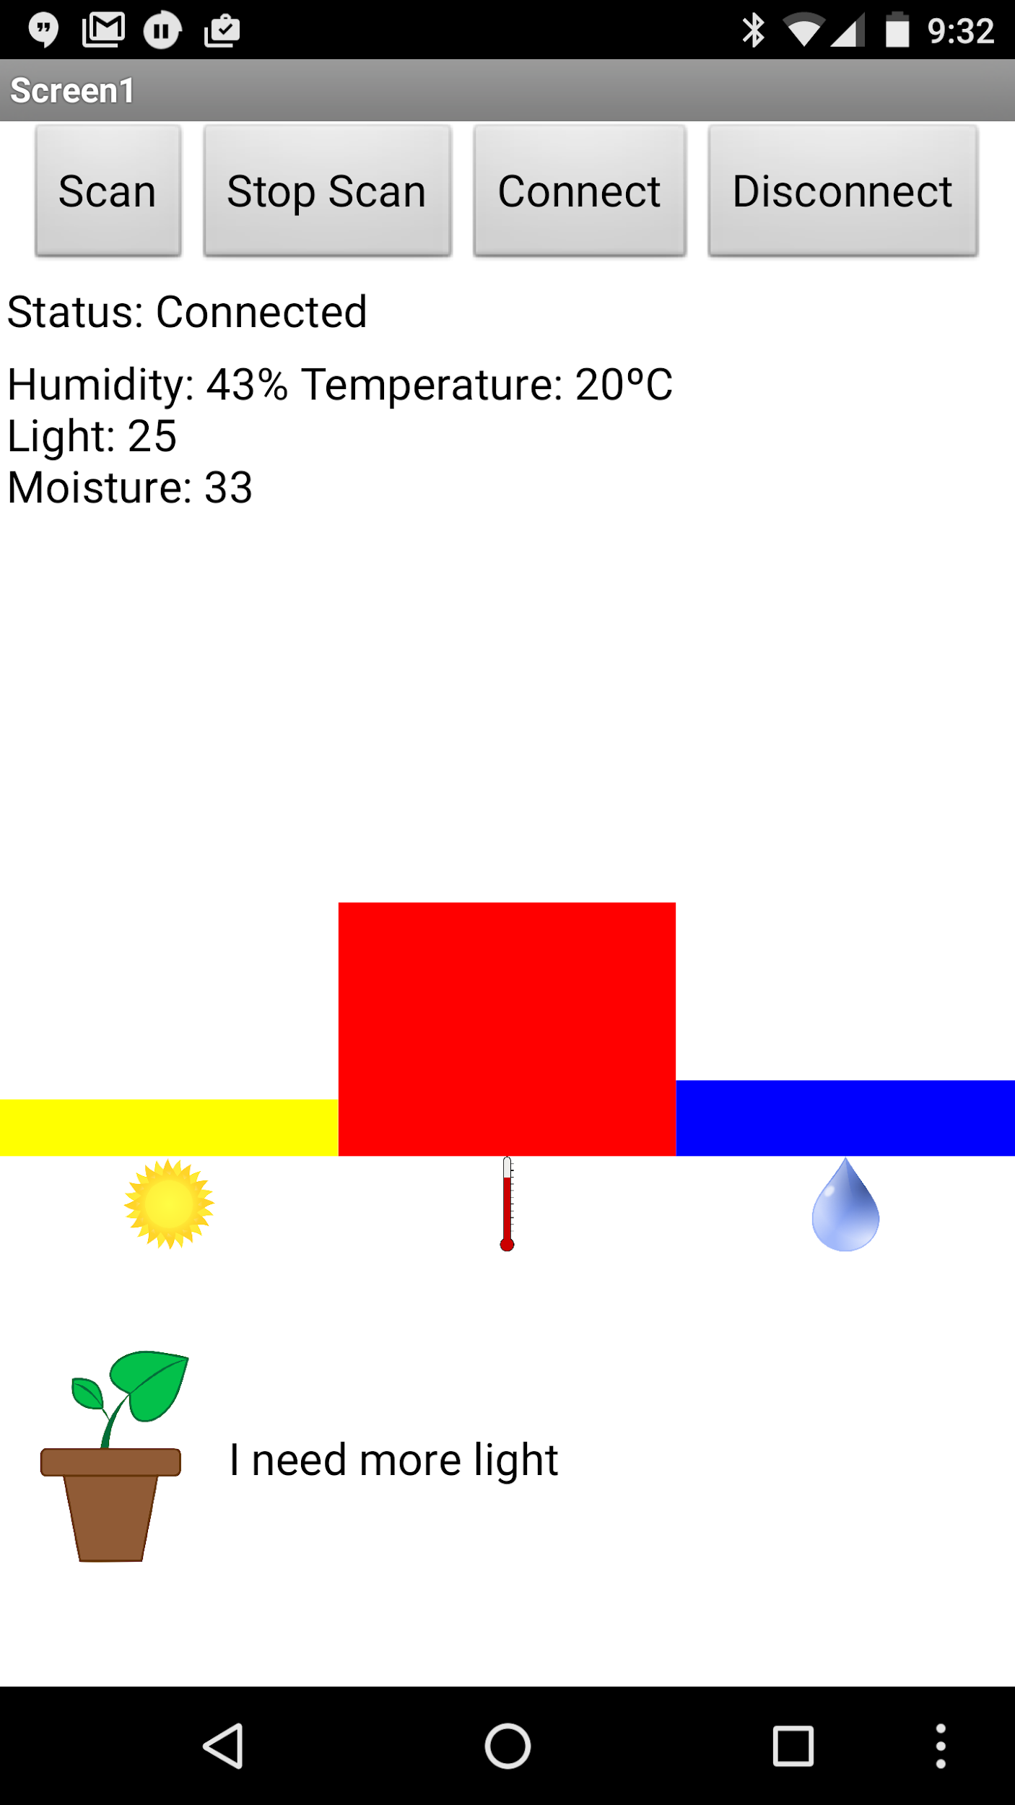
Your final app should look something like this:

Slide 17
Reflection
How did your app today interact with the world? What kind of sensors did you use and what data did it collect?
What other kind of application would you like to build?
What kind of data would be collected with this new app? What kind of sensors would you need?

